Slide 1
Cricket Protection: GAI Pilot
Venkat Srinivasan
Harsh Patel
Venkata Subramanian Srinivasan
February 20, 2025

Slide 2
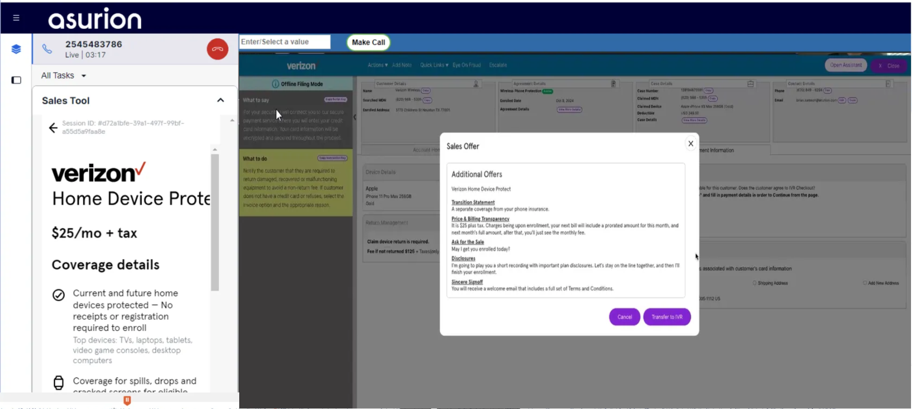
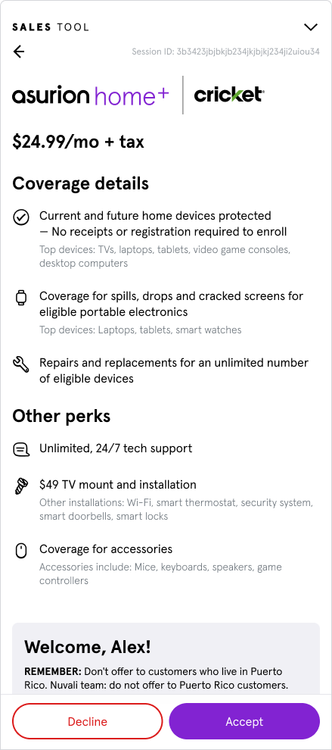
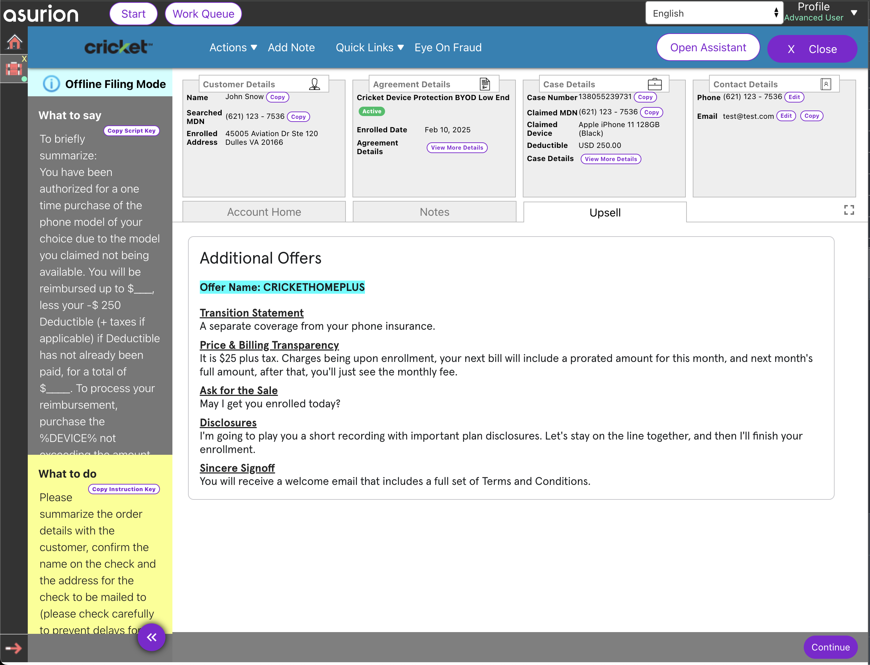
[Current] Sales Offer + Accept/Decline offer + Enroll
Static Coverage Details in ASP
1
1
2
Static Sales GPS scripting in Alpha to guide experts into a compliant sales offer
2

Slide 3
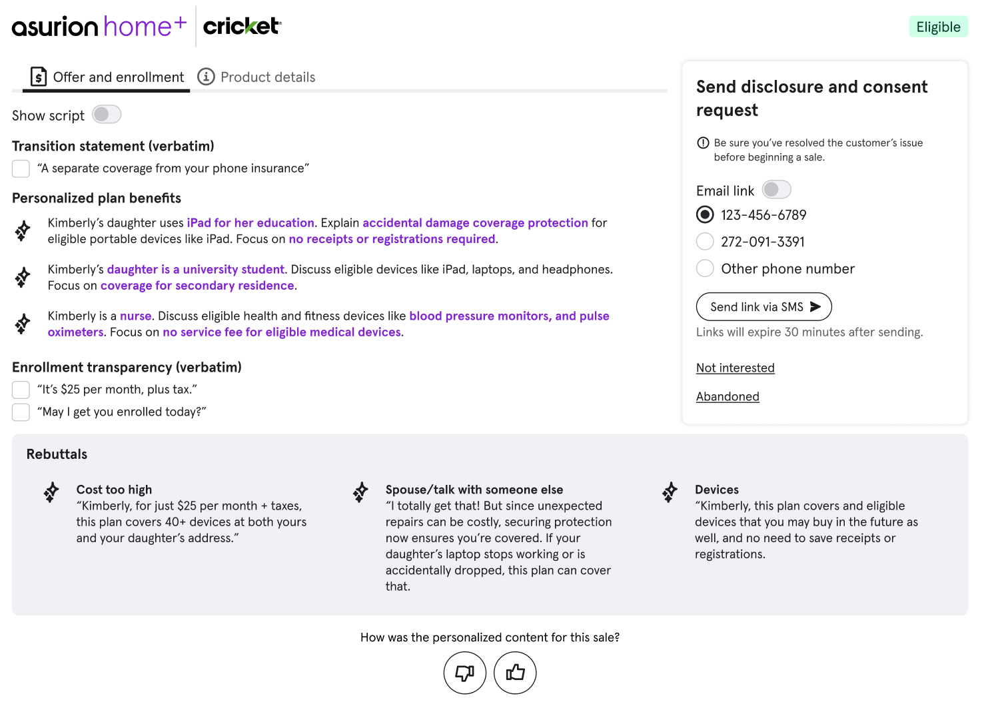
Compelling & Personalized Gen AI sales offer
Compelling & Personalized Gen AI sales offer _{(vs Static)} content will be available in Alpha to aide the expert in selling (Bullets & Script version available)
Key Product Benefits
Repair, Replace, Reimburse
Coverage beyond Cricket-purchased devices
Future devices
ADH
Low Service Fees
+
Key customer traits
1. **Household Situation**: The customer mentioned having a great-grandson and a granddaughter.
2. **Devices Owned**: The customer bought an iPhone 13 for their great-grandson.
3. **Lifestyle**: The customer mentioned going to the store and losing the device there.
4. **Pain Points**: The customer expressed frustration over the lost device and the inconvenience it caused.
5. **Priorities**: The customer is concerned about the timely replacement of the device and tracking the delivery.
Mr. Reveles, if you own laptops, the AHP plan ensures that you can get them repaired, replaced, or reimbursed without the hassle of providing receipts or registration.
For your great-grandson and granddaughter, if they use tablets, the AHP plan covers accidental damage like spills and cracked screens, which is a common issue with eligible portable devices.
Additionally, if your family enjoys gaming, the AHP plan covers gaming systems like XBOX or PlayStation, providing peace of mind for any potential damage or issues.
“It’s $24.99 per month, plus tax”
Cost
I appreciate anyone who’s aware of their finances, Mr. Reveles, and I want to assure you that the AHP plan offers service fees as low as $0 and never above $99 for approved claims, making it a cost-effective way to protect your valuable eligible tech devices in the long run.
Time to think
I get that! Here is why I believe it’s important to get you enrolled today: the 24/7 tech support starts immediately, ensuring you have help with any tech issues from day one.
Other Warranty
It's great that your tech is protected, Mr. Reveles, but the AHP plan covers over 40+ eligible devices for just $24.99 plus tax, potentially offering broader and more cost-effective protection.

Slide 4
Compelling & Personalized Gen AI sales offer
Rebuttal content easily accessible
Key Product Benefits
Repair, Replace, Reimburse
Coverage beyond Cricket-purchased devices
Future devices
ADH
Low Service Fees
+
Key customer traits
1. **Household Situation**: The customer mentioned having a great-grandson and a granddaughter.
2. **Devices Owned**: The customer bought an iPhone 13 for their great-grandson.
3. **Lifestyle**: The customer mentioned going to the store and losing the device there.
4. **Pain Points**: The customer expressed frustration over the lost device and the inconvenience it caused.
5. **Priorities**: The customer is concerned about the timely replacement of the device and tracking the delivery.
Mr. Reveles, if you own laptops, the AHP plan ensures that you can get them repaired, replaced, or reimbursed without the hassle of providing receipts or registration.
For your great-grandson and granddaughter, if they use tablets, the AHP plan covers accidental damage like spills and cracked screens, which is a common issue with eligible portable devices.
Additionally, if your family enjoys gaming, the AHP plan covers gaming systems like XBOX or PlayStation, providing peace of mind for any potential damage or issues.
“It’s $24.99 per month, plus tax”
Cost
I appreciate anyone who’s aware of their finances, Mr. Reveles, and I want to assure you that the AHP plan offers service fees as low as $0 and never above $99 for approved claims, making it a cost-effective way to protect your valuable eligible tech devices in the long run.
Time to think
I get that! Here is why I believe it’s important to get you enrolled today: the 24/7 tech support starts immediately, ensuring you have help with any tech issues from day one.
Other Warranty
It's great that your tech is protected, Mr. Reveles, but the AHP plan covers over 40+ eligible devices for just $24.99 plus tax, potentially offering broader and more cost-effective protection.

Slide 5
How are sales pitches generated?
Step 1:
Personalization
Step 2:
Compliance

Slide 6
Product features used to generate personalized offer
Step 1: Personalization
High-Priority Product features
Protection – Repair, Replace, or Reimburse Eligible Home Tech Protection
Current & Future Eligible Home Tech – No Receipts or Registration Required
Covers Eligible Products Extends coverage beyond Cricket-purchased devices
Low-Priority Product Features
ADH (Accidental Damage from Handling) – Covers spills, cracked screens, and other damage Accidental damage
Service Fees as Low as $0 and Never Above $99 for Approved Claims
Notes:
Top Priority (The Core of the Service / Ideally every customer would learn this info or the majority)
Mid-Priority (Useful but Less Critical / For the right customer, these could be a Top Priority and tie to specific devices or lifestyle profile)

Slide 7
Step 2: Compliance
All generated sales pitches and rebuttals are checked and rectified based on distilled rules extracted from the following documents:
Compliance Matrix*
Asurion Homeplus Terms and Conditions for Partners**
*Compliance Matrix at Sub-behavior level
**Asurion Homeplus T&C for Partners

Slide 8
Compliance matrix on the generated pitches
Out of scope | In scope
T3 behaviors Adding Without Consent or Failing to Allow Informed Consent Inhibiting Customer's Ability to Complete Claim* Obstructing or Refusing Service Completion Without the Sale Creating/Aiding to Create an Artificial Sale Unauthorized Collection of Customer Data for Sales Purposes T2 behaviors Pressure – Rebuttals | T2 behaviors Pressure – Threat Pressure – Urgency and Exclusivity Downgrade – Improper Comparison Downgrade – Advise to cancel Misrepresenting Disclosure Information T1 behaviors Misrepresenting Non-Disclosure Information
*Not applicable since the pitch is generated after submitting the claim

Slide 9
Plan Overview:
Plan Name: Asurion Homeplus (Make sure that plan name is mentioned at least once)
Cost: $24.99 plus applicable taxes per month
Renewal: The plan automatically renews each month until canceled.
Optionality: The plan is optional, and you may cancel at any time.
Coverage: Repairs, replacements, or reimbursement on eligible home tech products.
Exclusions: The plan is not insurance and must be called a contract.
Effective Coverage Date: Tech support is available on Day 1, while all other coverage starts on Day 31. Pre-existing conditions are not covered.
Service Fees: Up to $99 plus tax per approved claim.
Claim Limits: Up to $2,000 per claim and $5,000 aggregate in a rolling 12-month period.
Instructions:
Evaluate the given sales pitch, sentence(s), or bullet points to ensure compliance.
Ensure the correct terminology is used (e.g., "eligible products” or “eligible home tech” instead of just "products" or "devices").
Verify that all claims regarding coverage, service fees, limitations, and exclusions are accurate per the plan terms.
Do not add unnecessary details but make modifications to ensure compliance.
If a device type is mentioned, ensure it is part of the covered product list and accurately represented in terms of protection (e.g., TVs are not covered for ADH).
Repairs, replacements, or reimbursement must always be mentioned together if referring to covered service outcomes.

Slide 10
Accidental Damage from Handling (ADH) is covered only for the following eligible devices:
laptops, tablets, portable DVD/Blu-ray players, portable handheld gaming devices, wearables, audio headsets, virtual reality headsets, and printer display screens.
A service fee applies for each approved claim as follows: $99 Service Fee (plus tax) for:
desktops, laptops, and tablets (PCs), printers, televisions, gaming systems, home theater systems, Bluetooth and Wi-Fi-enabled speakers, virtual reality headsets, and smartwatches.
$49 Service Fee (plus tax) for:
smart door locks, smart home security cameras, smart thermostats, smart video doorbells, audio headsets, and health and fitness bands.
No Service Fee applies to:
standalone routers, external hard drives, original remote controls, PC or gaming system accessories, DVD players, streaming devices, smart device hubs, smart light dimmers, and smart smoke and carbon monoxide detectors.

Slide 11
What is Not Covered
• Pre-existing conditions at enrollment.
• Cosmetic defects or non-operational components.
• Improper installation, unauthorized modifications, or use beyond manufacturer specifications.
• Consequential damages, loss of data, theft, or custom-built products.
• Preventative maintenance, software repairs, products without serial numbers, and products outside the U.S.
• Products connected to Cricket’s insurance or protection plans.
Things not to do:
Do not create an impression that charges do not begin on the day of enrollment
Do not advise the customer the plan is "no contract”
Do not offer coverage for multiple households or more than one address
Do not compare the current plan that the customer has to our homeplus plan, in the context of implying that one could replace the other.
Do not advise the customer to drop their existing Asurion/client plan or 'consolidate' in exchange of the CH plan the expert is selling.

